Slide 1
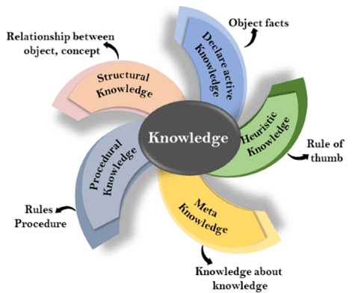
超越学科界限的认知基础 Transdisciplinary Cognitive Foundation
Knowledge Representation Week 6
Image Source: JavaPoint
Ben Koo
October 19, 2020

Slide 2

Abstract Specification
Logic Model
Logic Model
Concrete Implementation
Context: Cognitive activities can be managed in “Namespaces”
Goal: Make Knowledge Computable
Criteria:
Compliant with math insights
Intuitive for human recognition
Utilize Latest Technologies
Output: Render results on mobile devices with uni-expressiveness
Process: Compute in “linked spaces”
Input:
Category Theory nomenclature
Analogies as Universal Constructs
Digital Workflow with IoT/DevOps
A well-defined set of Actions and iterative Branching Strategies
A Roadmap of composable activities
Sequencing and timing conditions
Explicitly state dependencies and resource requirements
Boundary Conditions: Unfamiliarity with Namespace, Category Theory/Computing Science Terminology

Slide 3
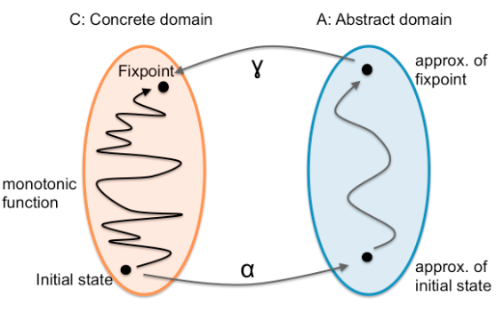
What is Knowledge?
How to convert a problem to a format with known solution,
then, relate it back.

Slide 4
A simple exercise
Can you connect the dots from
A to A’, B to B’, and C to C’ without crossing any lines?
A
C
B
C’
B’
A’

Slide 5
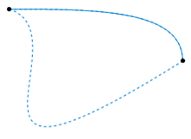
What is a Homotopy?
The two dashed paths shown above are homotopic relative to their endpoints. The animation represents one possible homotopy.
Image and Text Source: https://en.wikipedia.org/wiki/Homotopy

Slide 6
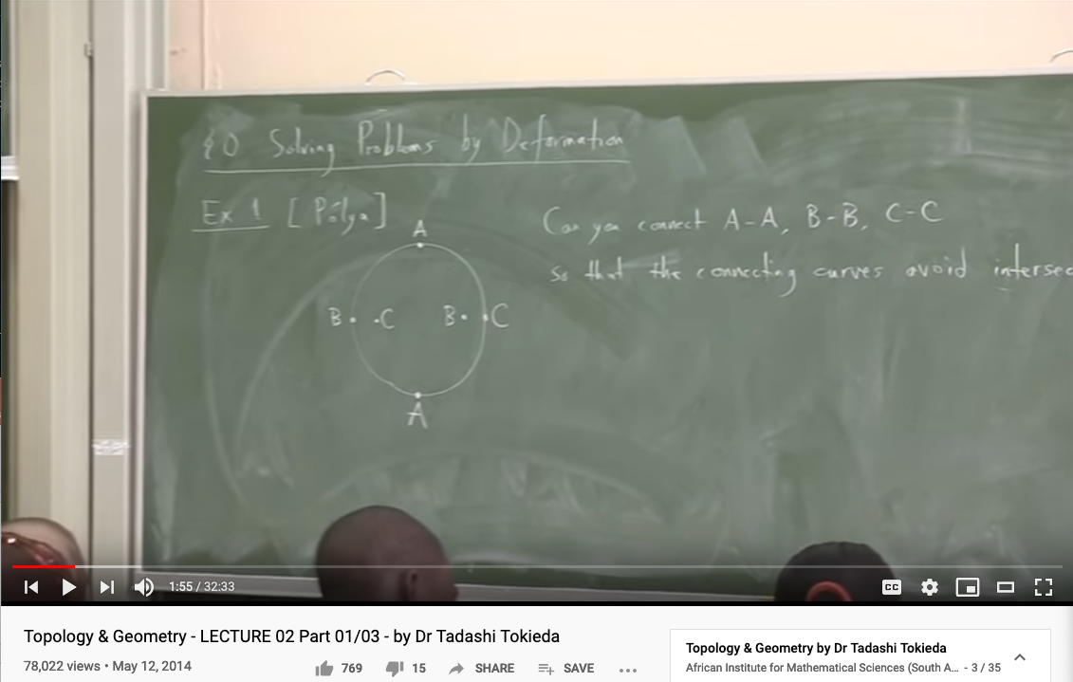
Knowledge Representation in Topology
Youtube Link: https://youtu.be/8YDw4YxT-FM?t=398

Slide 7
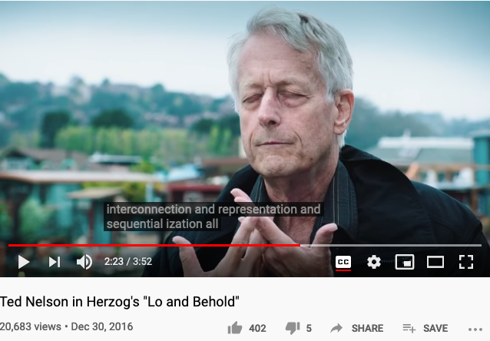
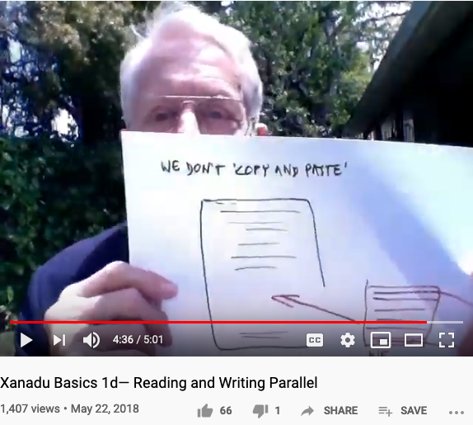
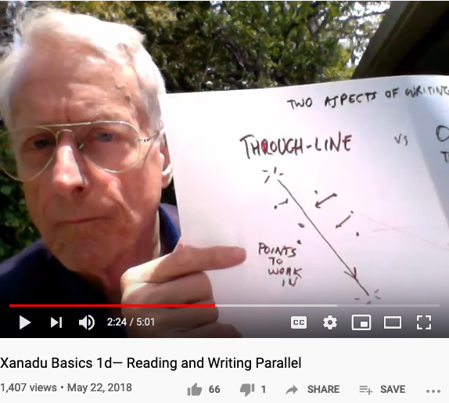
Let’s listen to Ted Nelson’s confession (again)
It was an experience of water and interconnection.
I was with my grandparents in a row boat in Chicago,
so I must have been five years old.
I was trailing my hand in the water and I thought about how the water was moving around my fingers, opening on one side and closing on the other, and that changing system of relationships where everything was kindof similar, kind of the same and the are different that was so difficult to visualize and express and just generalizing that to the entire universe that the world is a system of ever-changing relationships and structures, struck me as a vast truth… expressing that interconnection has been the center of all my thinking and all my computer work has been about expressing and representing and showing interconnection among writings especially. And writing is the process of reducing a tapestry of interconnection into a narrow sequence… they change the meaning of cut-and-paste and pretended it was the same thing… because humanity has no decent writing tools. … I consider that to be a crime against humanity and … this is the problem of interconnection and representation and sequentialization all similar to the issue of water.
- Youtube link: Lo and Behold the movie, section on interviewing Ted Nelson
Ted Nelson : “We don’t copy and paste, we transclude.”

Slide 8
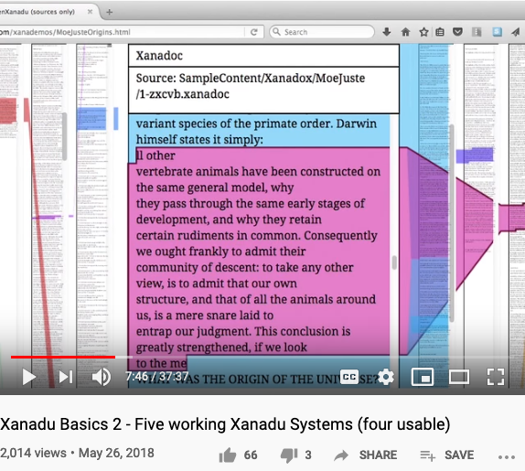
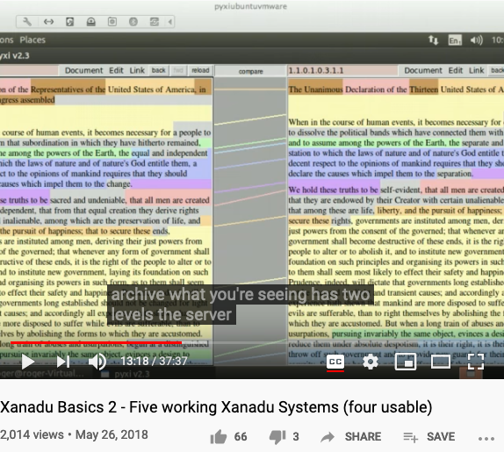

Some implementations of Ted Nelson’s Xanadu
Xanadu Classic is both an Operating System and a Document Management System.

Slide 9
Goal: Make Knowledge Computable

Slide 10
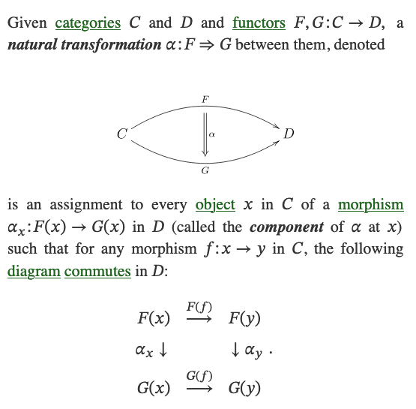
What is a Natural Transformation?
The two dashed paths shown above are homotopic relative to their endpoints. The animation represents one possible homotopy.
Image and Text Source: https://ncatlab.org/nlab/show/natural+transformation

Slide 11
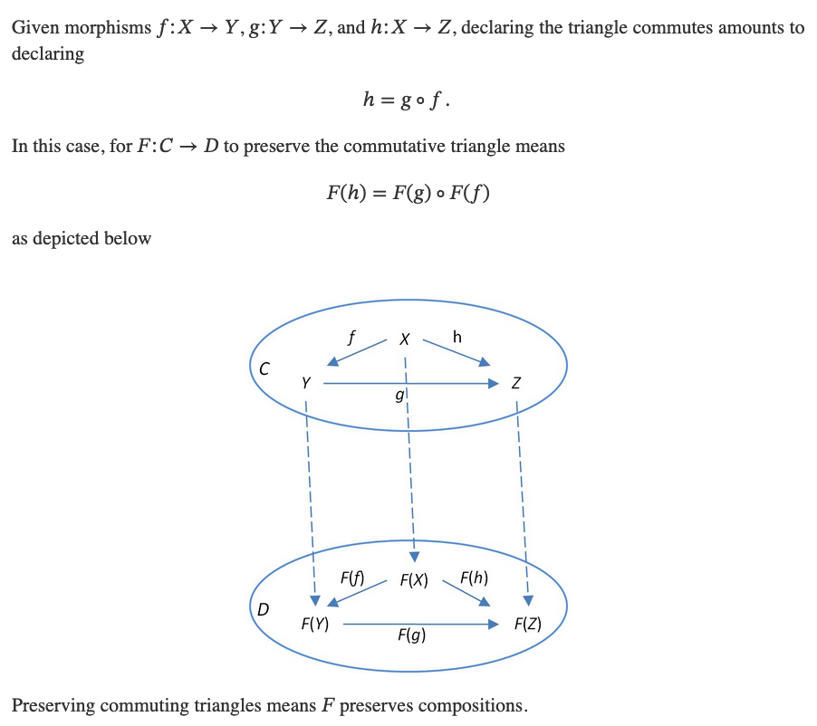
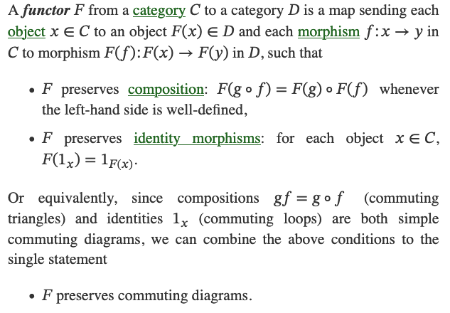
What is a Functor?
Image and Text Source: https://ncatlab.org/nlab/show/functor

Slide 12
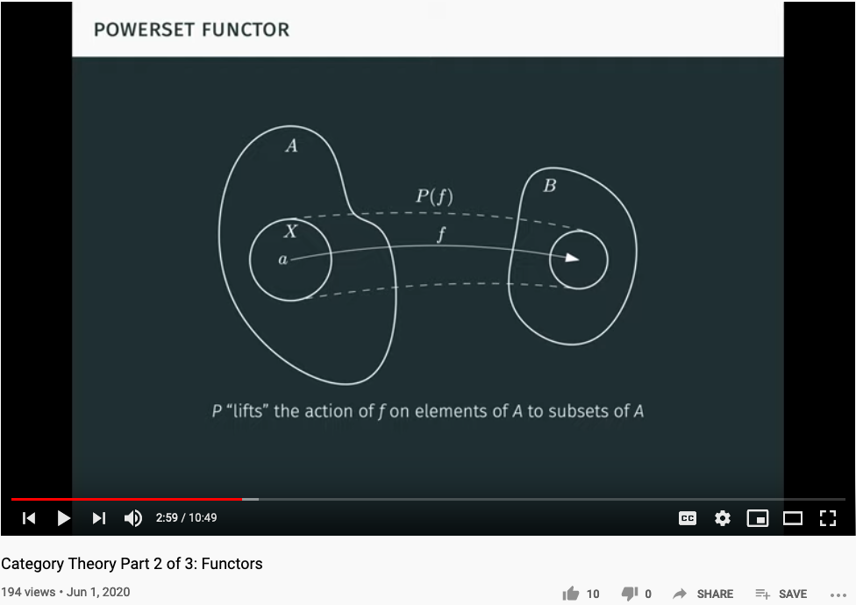
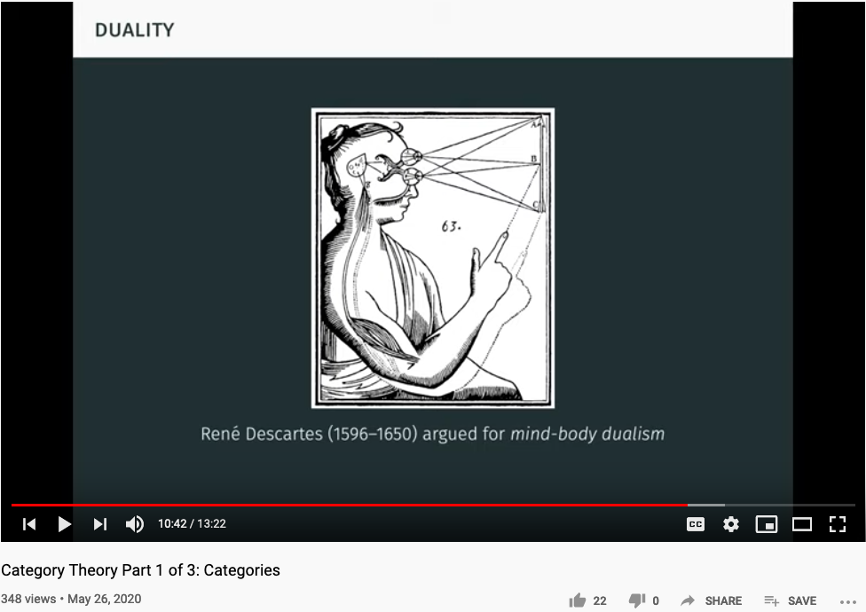
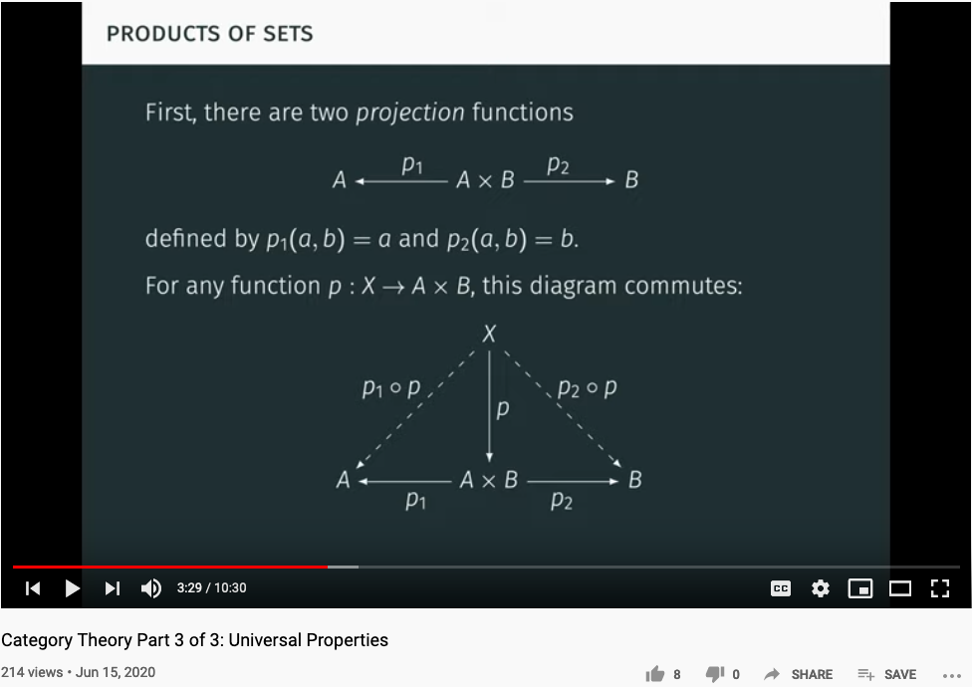
Functor as Structure Preserving Arrow
Youtuber blargoner: An introduction to categories, functors, and universal properties, with applications to the lambda calculus and functional programming.

Slide 13
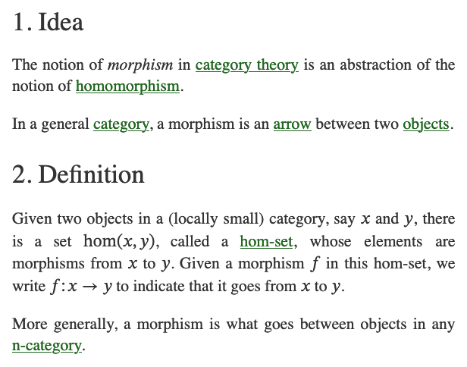
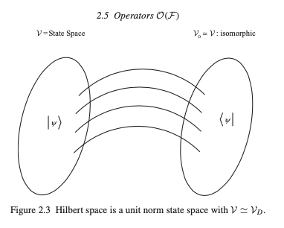
What is a Morphism (Function)?
Image and Text Source: https://ncatlab.org/nlab/show/morphism
Image Source: P.15 of Path Integral and Hamiltonian by Belal Baaquie

Slide 14
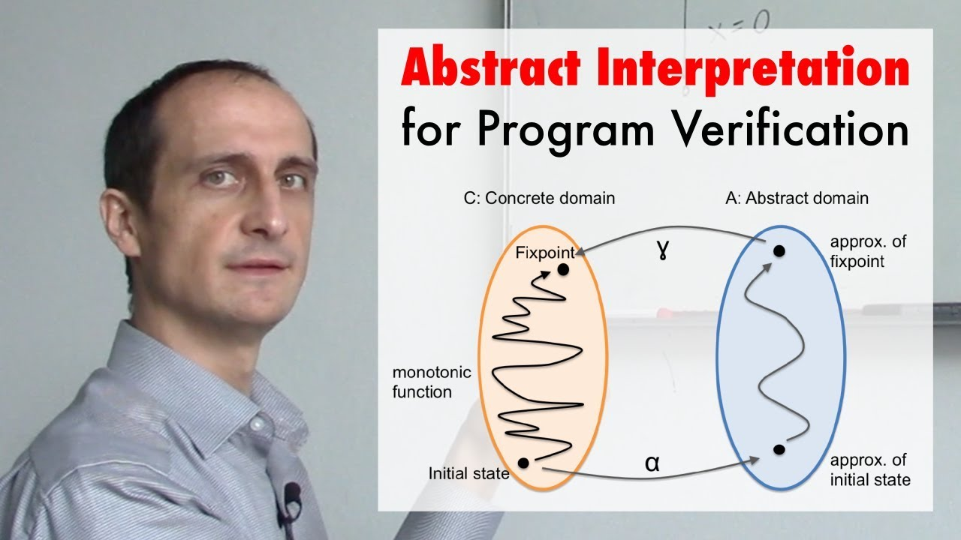
Representing Knowledge with Limited Resources
https://youtu.be/j2m5YMnHvQQ

Slide 15
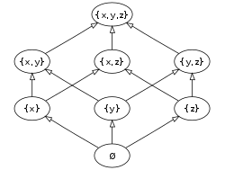
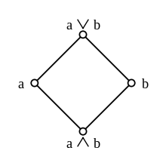
Abstract Interpretation is founded on Partially Ordered Set
Top
Joint/Supremum
(Least Upper Bound)
Joint
Meet/Infimum
(Greatest Lower Bound)
Meet
Image Source: Wikipedia (Joint and Meet)
Bottom
The Hasse diagram of the set of all subsets of a three-element set {x, y, z}, ordered by inclusion. Distinct sets on the same horizontal level are incomparable with each other. Some other pairs, such as {x} and {y,z}, are also incomparable. (Image and Text Source: Wikipedia: POS )

Slide 16
Think about Physicist’s Namespace as a POS
Covariant Loop Quantum Gravity: An Elementary Introduction of Quantum Gravity Theory and Spinfoam Theory
by Rovelli and Vidotto

Slide 17
Mathematical Models: A Sketch for the Philosophy of Math (1981)
by Saunders Mac Lane, founder of Category Theory
Counting | Arithmetic, Number Theory
Measuring （度量） | Real Numbers, Calculus, Analysis
Shaping （分辨形体） | Geometry, Topology
Forming （成形） | Symmetry, Group Theory
Estimating （估测） | Probability, Measure Theory
Moving （移动） | Mechanics, Calculus, Dynamics
Calculating （计算） | Algebra, Numerical Analysis
Proving （证明） | Logic
Puzzling （解谜、加密） | Combinatorics, Number Theory
Grouping （聚类） | Set Theory, Combinatorics
Link to the online paper: Last accessed: October 18, 2020
Notes:
Category theory has become an important role in contemporary mathematics and theoretical computer science.

Slide 18
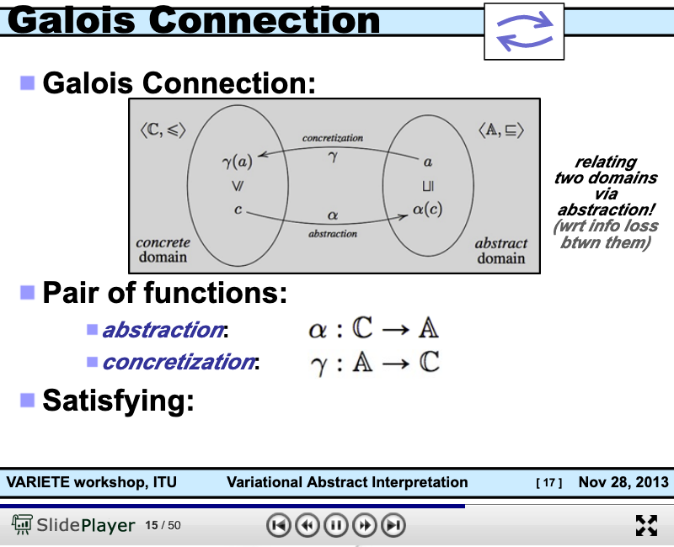
Connecting Abstract and Concrete Domains
https://slideplayer.com/slide/8506871/

Slide 19
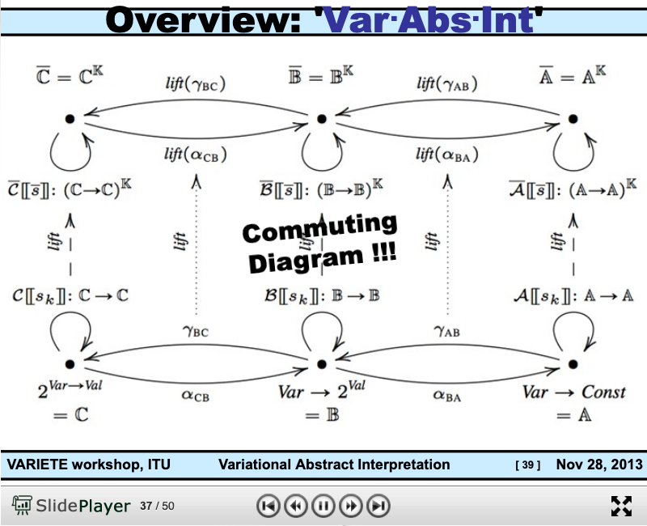
Arrow Chasing Computation
https://slideplayer.com/slide/8506871/

Slide 20
Criteria: Check if our strategy works
Compliant with math insights
Intuitive for human recognition
Utilize Latest Technologies

Slide 21
Abstraction
Concretization
Conditional Statements
Compliant with math insights?
Intuitive for human cognition?
Utilize latest technologies?
Matching Output and Inputs
Category Theory as a Universal Construct
Analogy in terms of linked structures and stretching geometries
Data Collection, Computing and Visualization Technologies
A well-defined set of Actions and iterative Branching Strategies
A Roadmap of composable activities
Sequencing and timing conditions
Explicitly state dependencies and resource requirements

Slide 22
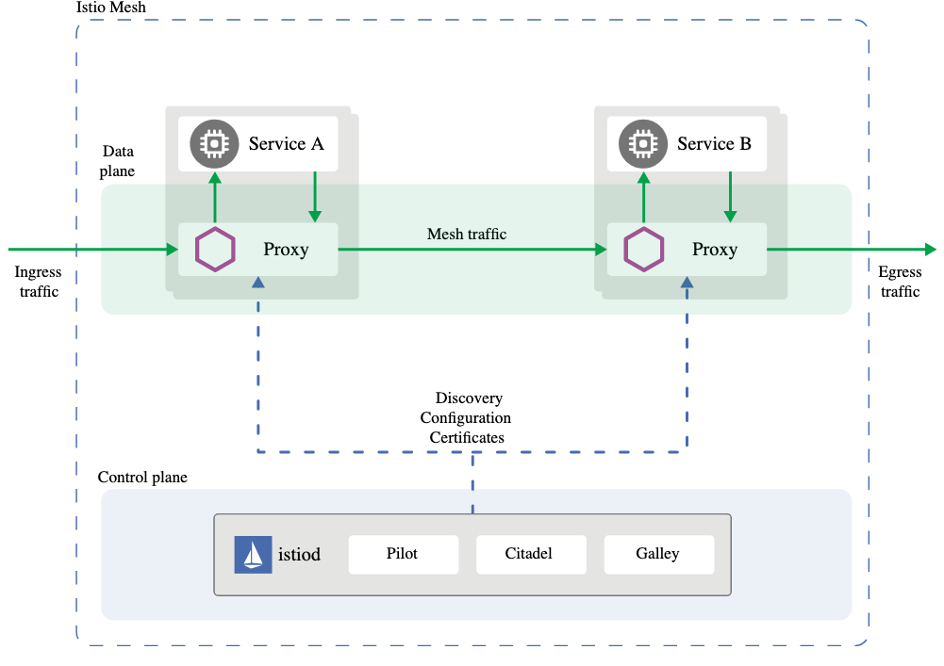
In the world of Internet of Things Checks and Balances
Data Plane
Abstraction
Concretization
Control Plane

Slide 23
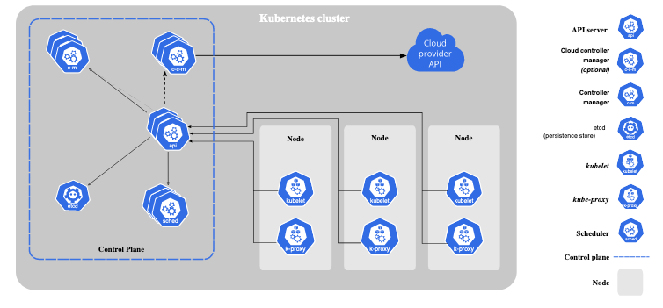
A New Kind of Operating Systems with built-in Governance
Data Plane

Slide 24
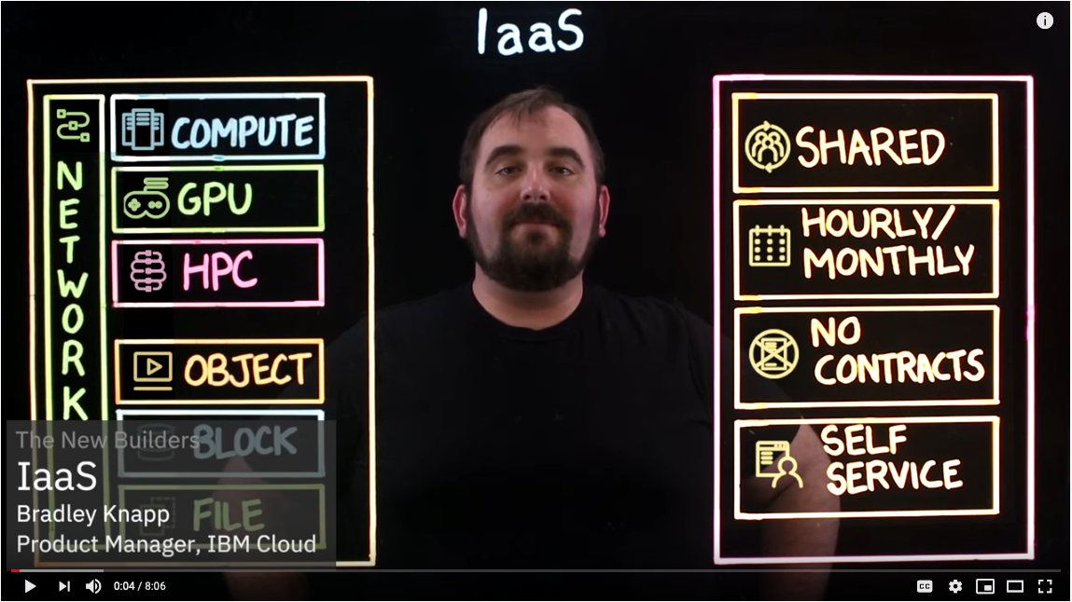
IaaS: Infrastructure as a Service

Slide 25
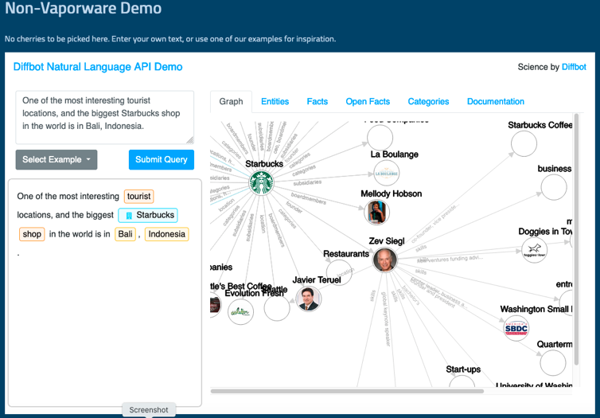
Unified Namespace

Slide 26
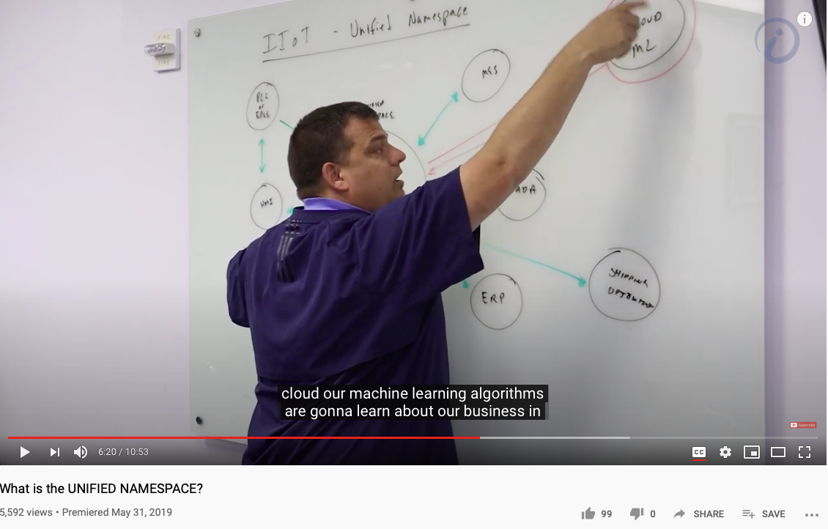
A Smart way to Govern Activities in Space-Time
Transform everything into Data
(Namespace Management)
Ongoing Development
RICH 70 Tsinghua SEA Cloud Forum, Sep 14, 2020
H. E. Bambang Brodjonegoro,
Minister of Research & Technology, Indonesia
Image credits: http://verses.io

Slide 27
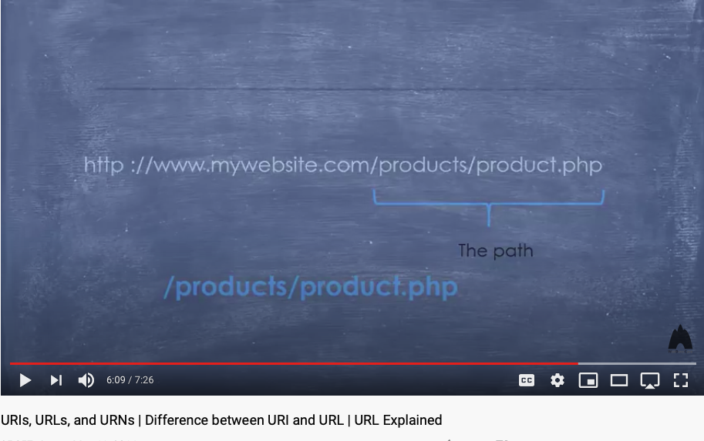
Universal Resource Locator, Identifier, Name as names of functions (especially with path information)
Video Link: https://youtu.be/vpYct2npKD8

Slide 28
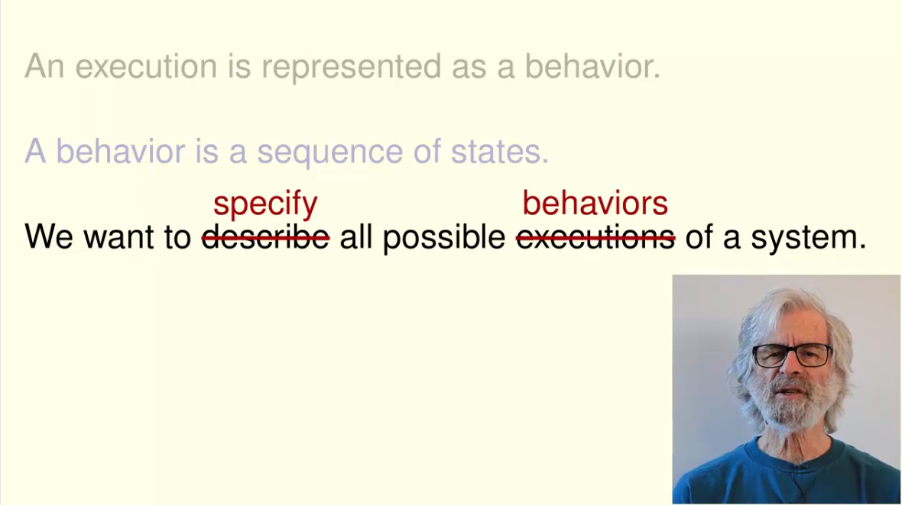
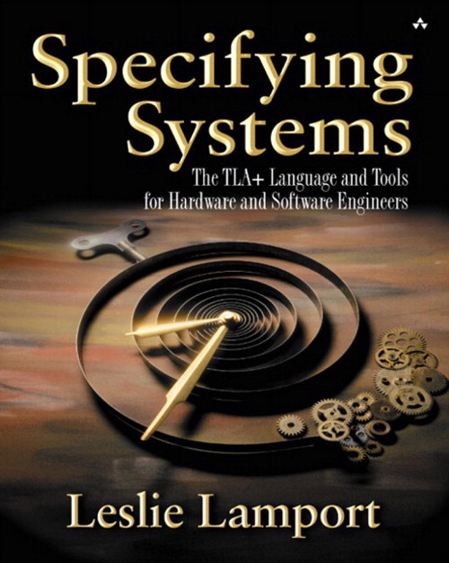
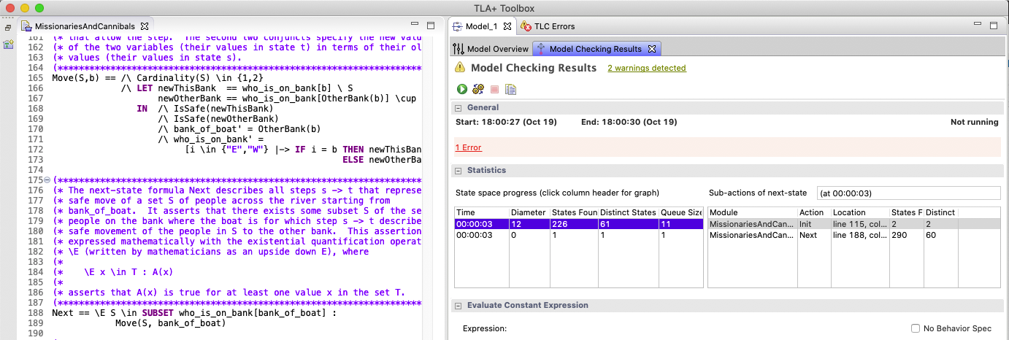
Paths as sequences of “Actions” with assigned names (state values)
Video Link: http://lamport.azurewebsites.net/video/intro.html

Slide 29
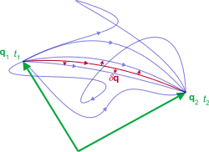
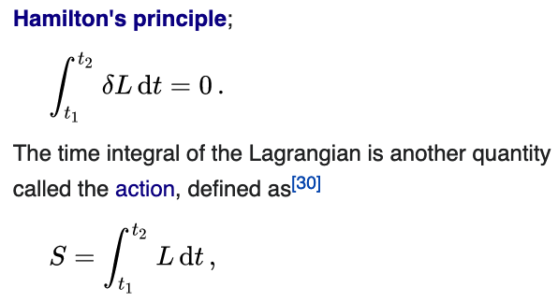
Representation of Action
Namespaces: labeled objects
Computations: transformative actions on the named objects
Action is a mathematical functional which takes the trajectory, also called path or history, of the system as its argument and has a real number as its result. Generally, the action takes different values for different paths.^{[1]} Action has dimensions of [energy]⋅[time] or [momentum]⋅[length], and its SI unit is joule-second. Action is only of interest when the total energy of the system is conserved.^{[2].}
- Wikipedia: Action
As the system evolves, q traces a path through configuration space (only some are shown). The path taken by the system (red) has a stationary action (δS = 0) under small changes in the configuration of the system (δq).^{[1]}
Source of Image and Text: Wikipedia on Hamilton’s Principle
Source of Image and Text: Wikipedia on Lagrangian Mechanics

Slide 30
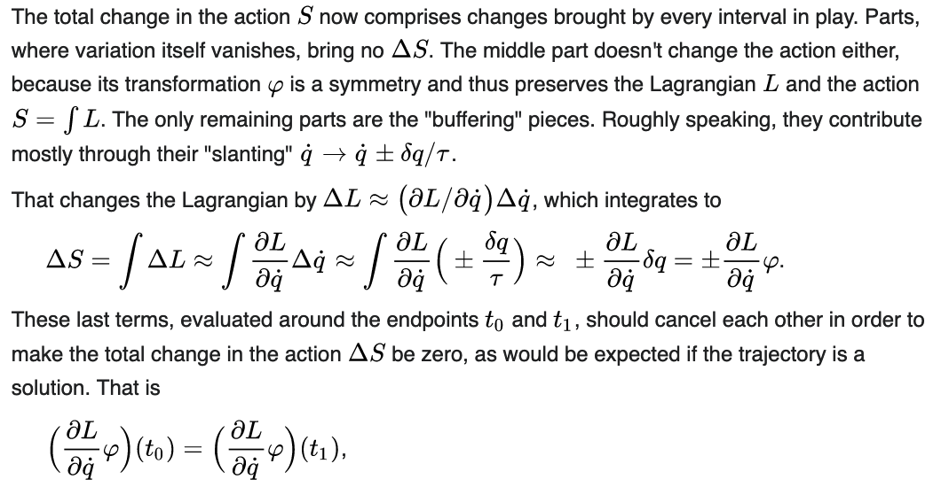
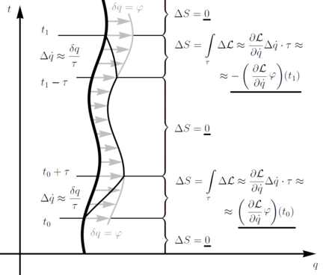
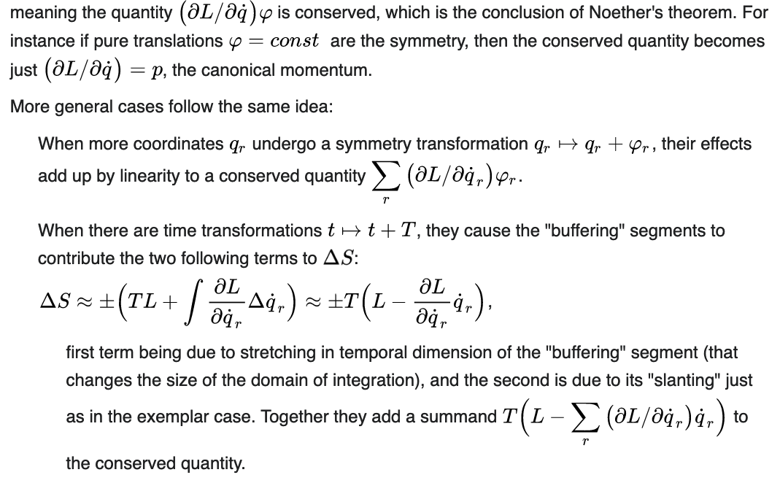
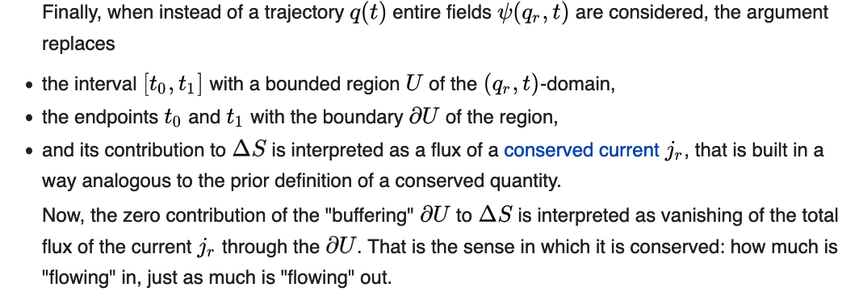
Change in Action S across multiple intervals
Source of Image and Text: Wikipedia on Noether’s Theorem

Slide 31


Category Theory can generate concrete solutions
NKS 2004, MIT A New Kind of Language for Complex Engineering Systems
Case Study: NASA’s Apollo Program Benjamin Koo
Edward F. Crawley
Represents Technologically Feasible trajectories to the moon

Slide 32
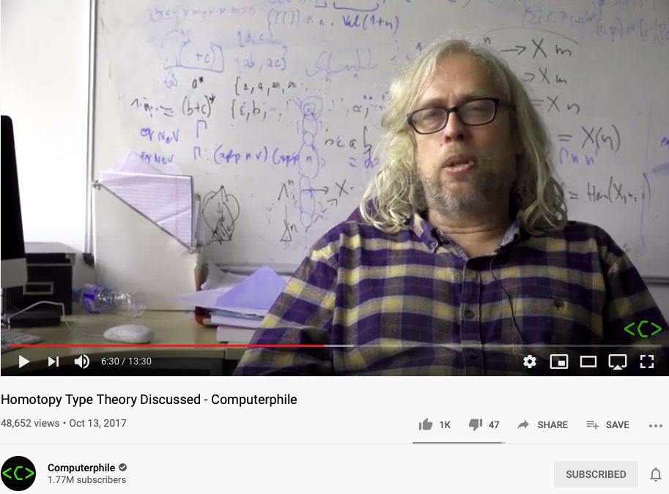
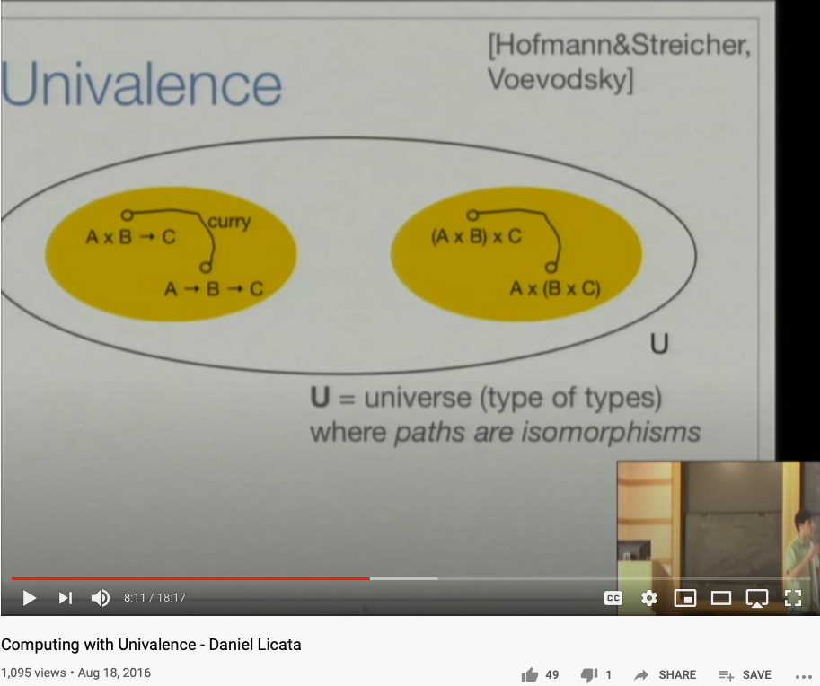
Representing Functions as Paths
Video Link: https://youtu.be/Ft8R3-kPDdk?t=390
Video Link: https://youtu.be/YDdDuq2AGw4

Slide 33
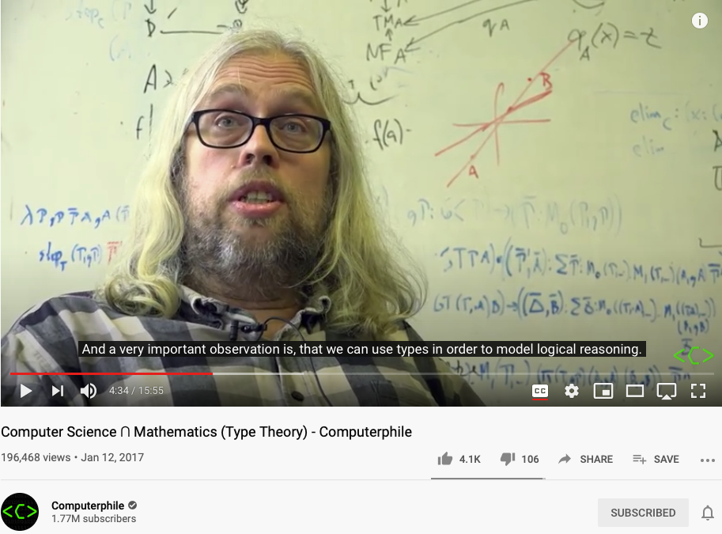
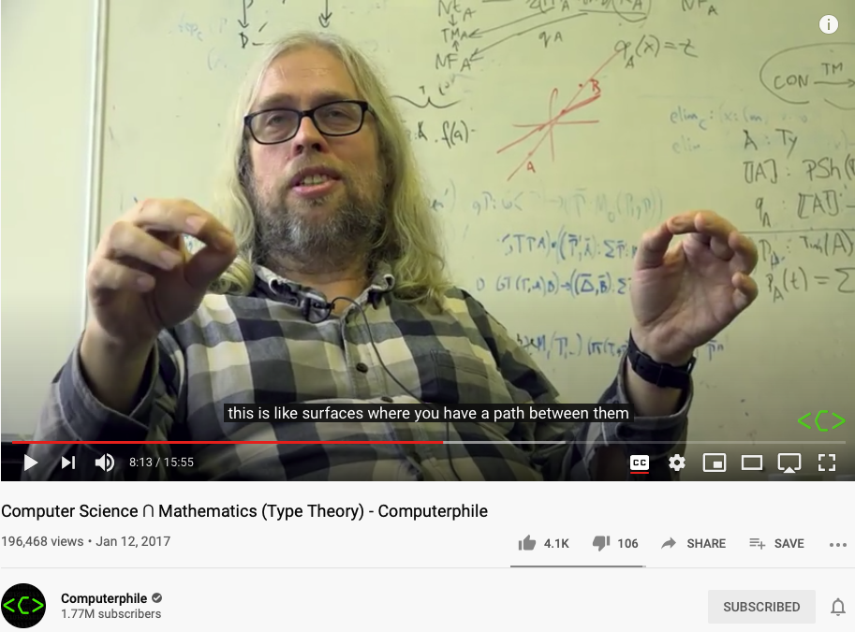
Modeling everything as Types of Functions
Because we cannot talk about implementation details, so that two things behaves the same on the outside must be the same.
This is the nature of
Namespace Management.
Video Link: https://youtu.be/qT8NyyRgLDQ?t=274
Video Link: https://youtu.be/qT8NyyRgLDQ?t=493

Slide 34
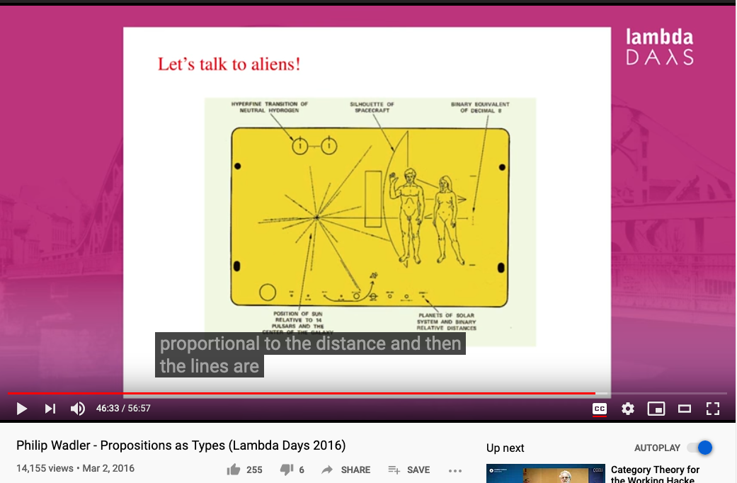
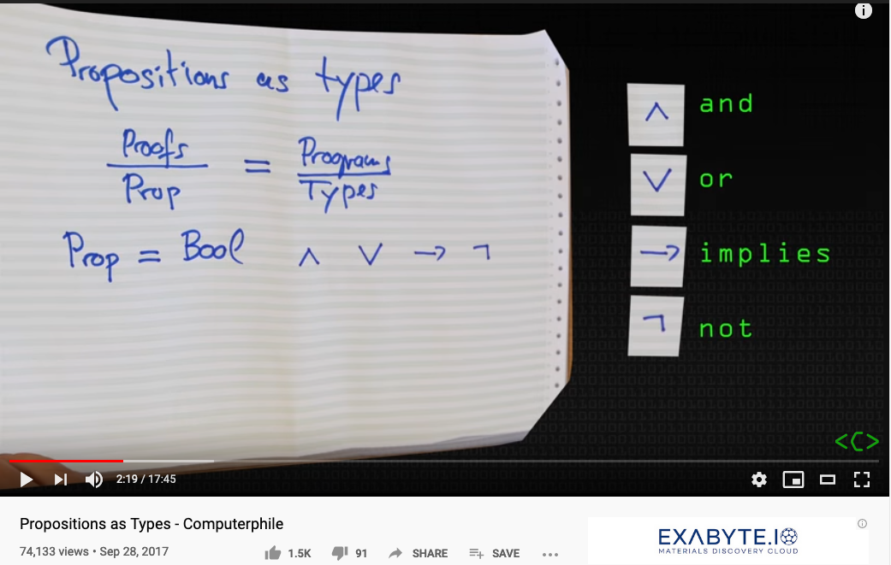
Representing Types (names with intensive properties)
IN a tautological statement, all unique namespaces will possess the same logical meaning.
Video Link: https://youtu.be/SknxggwRPzU?t=139
Video Link: https://youtu.be/aeRVdYN6fE8?t=2793

Slide 35
NsM complements Type Theory
(Logical) Propositions are types.
Types can be given concrete names.
Significant amount of logical reasoning can be automated.

Slide 36
The nature of “arrow” and its Universal expressive powers in Knowledge Representation

Slide 37
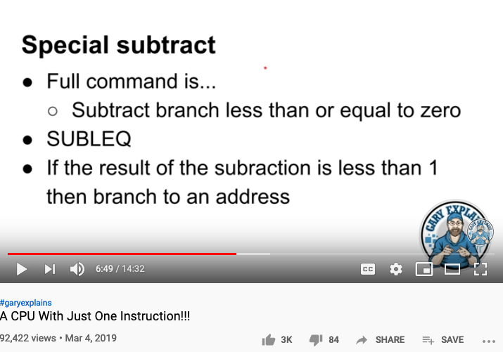
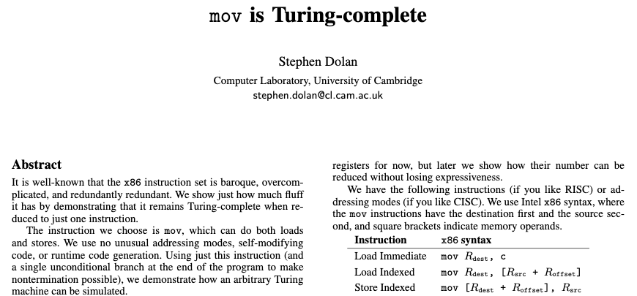
A CPU with One instruction
Stephen Dolan’s paper on Turing Completeness with one instruction
https://youtu.be/jRZDnetjGuo?t=409

Slide 38
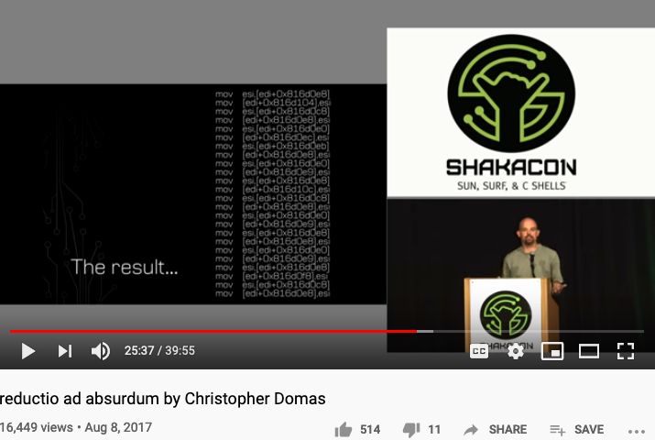
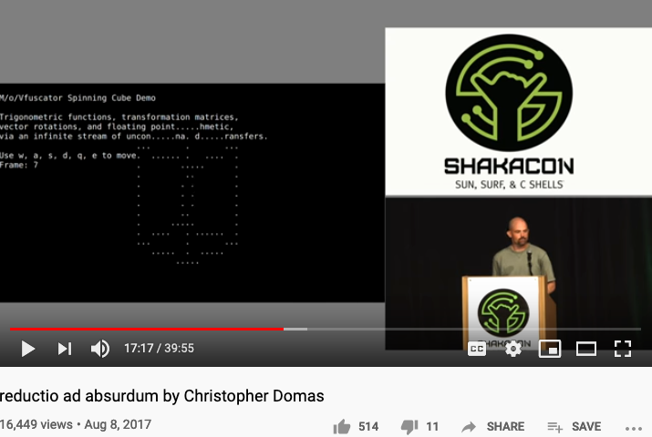
One instruction for All Computation
https://youtu.be/NmWwRmvjAE8?t=1037
Representing all computational actions with just one instruction, MOV

Slide 39

The Master Algorithm that will rule the world?
Bill Gates recommended this book
in 2016 Code Conference
The thesis:
Processing data through a single universal learning algorithm— can get all the knowledge from the past, the present, and the future
Pedro Domingos, TMA, P. 25
Chinese Translation
39

Slide 40
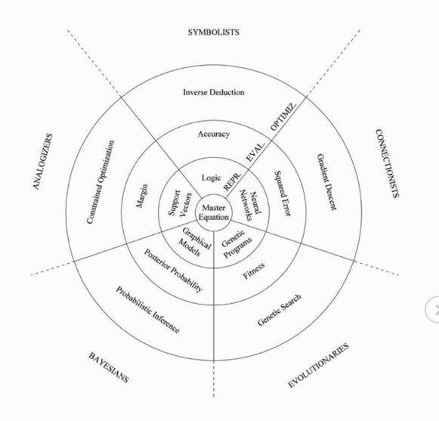
The Five Flavors of Master Algorithm
Image Source: Master Algorithm
Image Source: JavaPoint

Slide 41
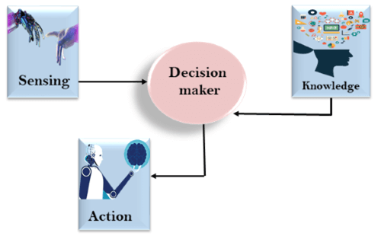
The Modern Workflow of Human Actions
Data Plane
Control Plane
Images from: JavaPoint

Slide 42
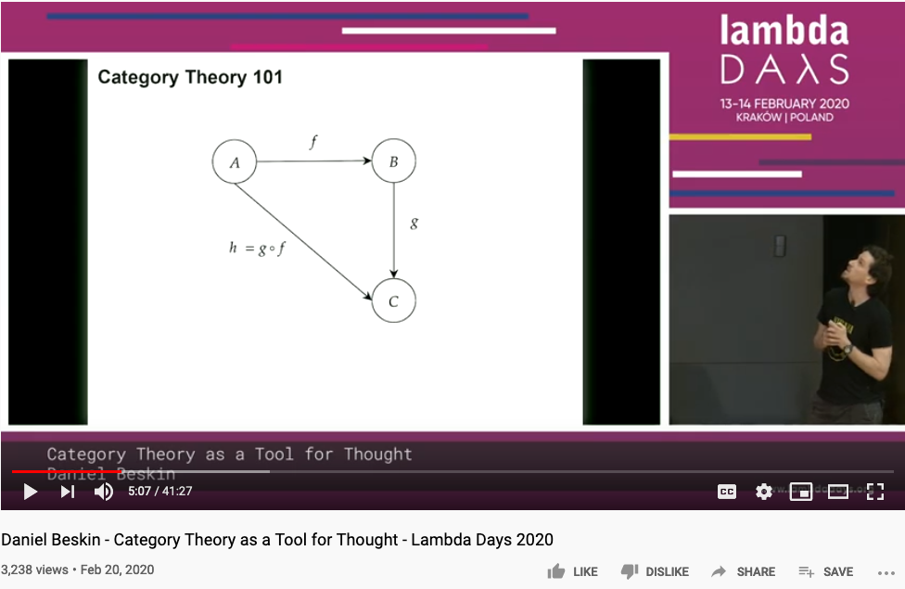
Category Theory is all about Composing Arrows

Slide 43




Functional Composition/
De-composition
C
C ^{OP}
3D printing
3D printing
g
F ^{op}
f
f ⁻¹
g ⁻¹
2D printing
1D movement
(Opposite Functor)
2D printing
1D movement

Slide 44


Universal Constructions as a “unique” strategy

Slide 45


All concepts (ideas) are Kan Extensions -Saunder Mac Lane
https://github.com/ncreep/category-theory-as-a-tool-for-thought

Slide 46


ALL Concepts can be represented using Kan Extension
Kan Extension: A highly rigorous mathematical construct for managing abstractions.
Khun Cycle: A generic model for managing scientific advancement/evolution based on Namespace Management.

Slide 47


Abundent Data Sources Available
https://youtu.be/r0lsyTaAuJE?t=16
https://youtu.be/EPs6BhLav94?t=32

Slide 48

Kuhn’s Cycle and Namespace Management
System Alert:
Mathematicians keeps inventing different Namespaces
https://www.thwink.org/sustain/glossary/KuhnCycle.htm

Slide 49


NsM with DevOps and CI/CD
https://youtu.be/p7-U1_E_j3w
https://youtu.be/p7-U1_E_j3w

Slide 50


Logic Model
Logic Model
Context: Cognitive activities can be managed in “Namespaces”
Goal: Make Knowledge Computable
Criteria:
Compliant with math insights
Intuitive for human recognition
Utilize Latest Technologies
Output: Linked namespaces can be rendered on mobile devices in modern browsers
Process: Compute in “Arrows” by following Category Theory
Input:
Category Theory allow namespaces to be stretched and compressed
Arrow/path Analogies provides a geometrical/visual understanding
Industry-strength tools available for data abstraction and collection/computation
A well-defined set of Actions and iterative Branching Strategies
A Roadmap of composable activities
Sequencing and timing conditions
Explicitly state dependencies and resource requirements
Boundary Conditions: Unfamiliarity with Namespace, Category Theory/Computing Science Terminology

Slide 51
Summary
Knowledge Representation can be grounded in a unifying theoretical framework (Category Theory).
Unification provides consistency, scalability, and knowledge reuse.
Existing tools and technologies can significantly reduce the cognitive complexity of their users

Slide 52
Your actions before Oct 26, 2020
Refine the Logic Model of your project, make sure that you have enough reference material
Try to relate your namespace in terms of Category Theory/Computing Science ideas
Refresh your Github content and include your with proper NsM
Couse Github @ https://github.com/benkoo/CognitiveFoundation2020
Integrate content in your learning report to the final report
Start compiling the weekly Logic Model into a meaningful story line
Prepare for a 15 minute presentation about your progress for next week

Slide 53



References

Slide 54


Reference to Homological Algebar series
Video Link: https://youtu.be/GGL6AZpO7Ck
Video Link: https://youtu.be/9pPS7iJ4grM
Youtuber Jeremy Mann: A mathematician interested in applying Category Theory to Data Science related problems.

Slide 55

The Best One Hour Summary of Category Theory
Category Theory for Beginners (video series) -Richard Southwell

Slide 56


Higher Dimensional Structure denoted by Arrows
https://youtu.be/lmcT2mP2bfE?t=183
https://youtu.be/lmcT2mP2bfE?t=481

Slide 57


The Idea of Multiplication expressed in Arrows
https://youtu.be/lmcT2mP2bfE?t=967
https://youtu.be/lmcT2mP2bfE?t=1021

Slide 58
The World According to Category Theory
Find an image that shows arrow that
points to another arrow
A mathematical foundation based on one notation: arrow!
Also known as the arrow chasing computation.

Slide 59



The Types of Arrows
If it looks like a pig, walks like a pig, and taste like a pig, it is a pig.

Slide 60

Vertical Composition
Page. 175 of Category Theory for Programmers

Slide 61

Horizontal Composition
Page. 176 of Category Theory for Programmers

Slide 62



Kleisli Arrow of outrageous Fortune

Slide 63
Category Theory and Unary Arithmetic
How to do computation with only one symbol?
Verbs and Nouns are the same type!
Operators and Operands are “Terms” (Names)

Slide 64


Functor in Action
https://youtu.be/XcM39gnqgNc?t=155
https://youtu.be/YLIH8TKbAh4?t=389

Slide 65



Various ways to interpret Natural Transformation
Think about Natural Transformations as various kinds of Abstract Interpretations?

Slide 66


Representing Graphical Information Content
LAMBDANETWORKS: MODELINGLONG-RANGEIN-TERACTIONSWITHOUTATTENTION
Authors anonymous, under double blind review (ICLR 2021) last access: Oct 18, 2020

Slide 67

Applied Category Theory
These mathematical ideas are strategies for Knowledge Representation

Slide 68


From Category Theory to Higher Type Theory
https://youtu.be/-DP0wY2FBs4?t=496
https://youtu.be/cmYzJAsjYSo

Slide 69


Category Theory is a way to formally represent “Analogies”
Let’s see the example :
Functor
Category
Natural Transformation
Source : Milewski, 2015

Slide 70
Partially Ordered Set (POS)
Top (Meet)
Bottom
The Hasse diagram of the set of all subsets of a three-element set {x, y, z}, ordered by inclusion. Distinct sets on the same horizontal level are incomparable with each other. Some other pairs, such as {x} and {y,z}, are also incomparable. (Image and Text Source: Wikipedia: POS )

Slide 71
Ontological Engineering (知识图谱)
Ontology engineering … studies the methods and
methodologies for building ontologies:
… formal representations of a set of concepts
… Core ideas and objectives of ontology engineering
are also central in conceptual modeling.
https://en.wikipedia.org/wiki/Ontology_engineering

Slide 72


可计算图形语意：Computable Semantics

